Slide 1

Lecture 3 Variable types & constructors

Slide 2
Variable types
Local Variables
Instance Variables

Slide 3
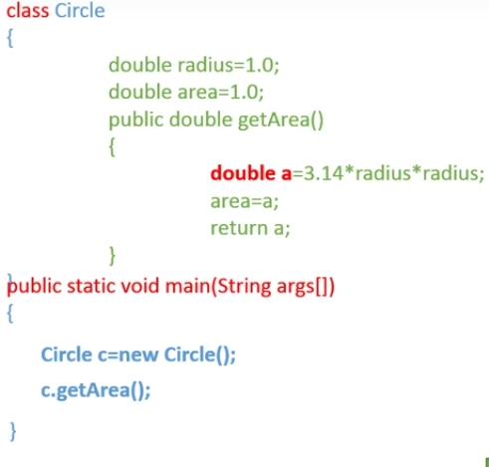
Variable LifeCycle

Slide 4
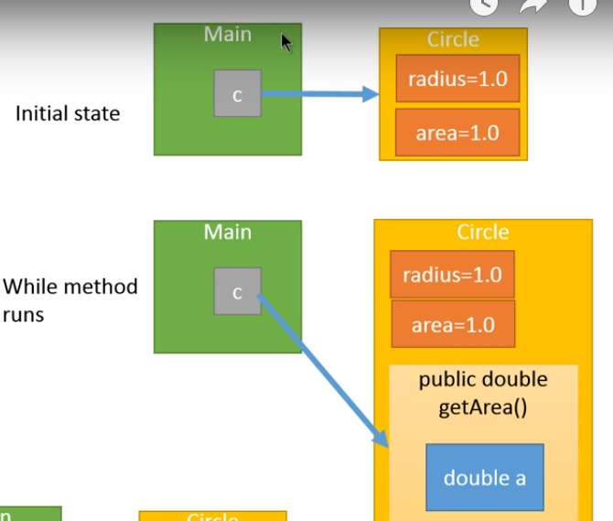

Slide 5


Slide 6
Local variable
Local variables are declared in methods, constructors, or blocks.
Local variables are created
When the method, constructor or block is entered
The variable will be destroyed
Once it exits the method, constructor, or block.
Local Variables must be intialzed

Slide 7
LOCAL VARIABLE

Slide 8
Instance Variable
Instance variables are declared in a class, but outside a method, constructor or any block.
Instance Variables

Slide 9
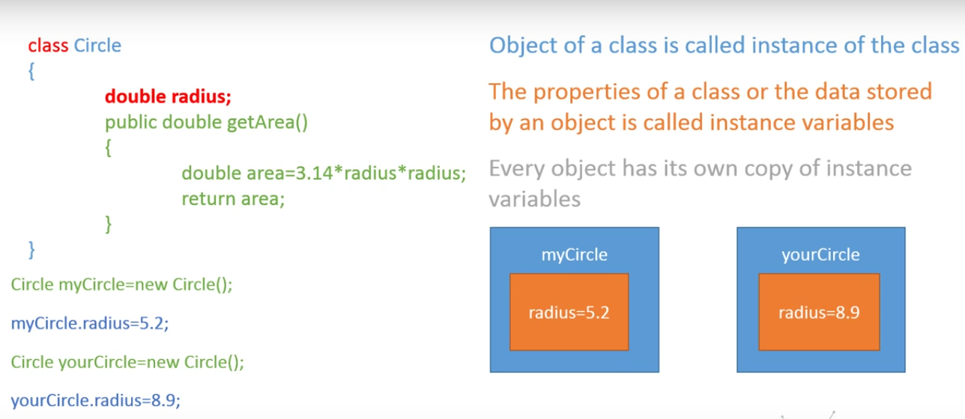

Slide 10
Instance Variables
Instance variables need not be initialized
Instance variables are alive as long as object is alive
Instance variables have default values. For numbers, the default value is 0, for Booleans it is false, and for object references it is null.
When objects are no longer in use they are destroyed by garbage collector.

Slide 11
Static Variable
Static variables are declared with the static keyword in a class, but outside a method, constructor or a block.
Only be one copy of each class variable
Constant variable declared as static
Numbers, the default value is 0;
For Booleans, it is false;
For object references, it is null

Slide 12
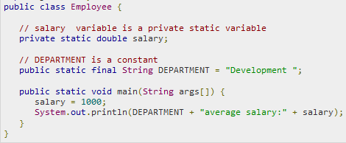

Slide 13
Constructor
When you create an object of a class using a new operator you invoke a special kind of method called a constructor
A constructor is used to perform initialization of instance variables of a class
Constructor is a special method that is called when you use the new operator.
Person p = new Person();
If you don't define a constructor java creates a default constructor that can assign default values for all your variables in the class.

Slide 14
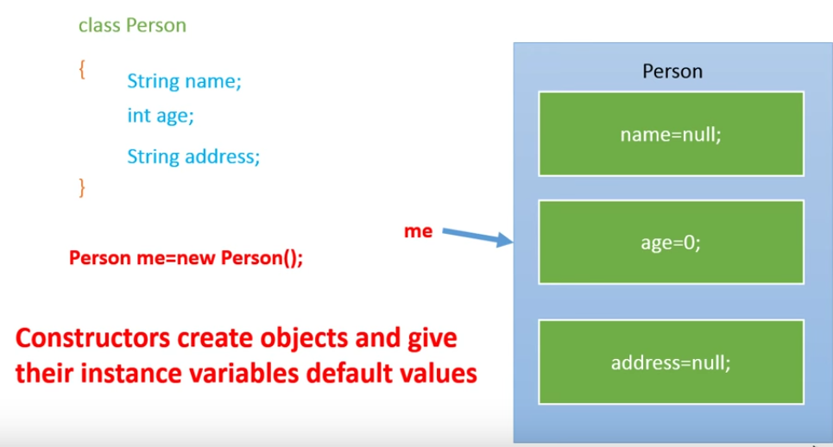
What does default constructor do?

Slide 15
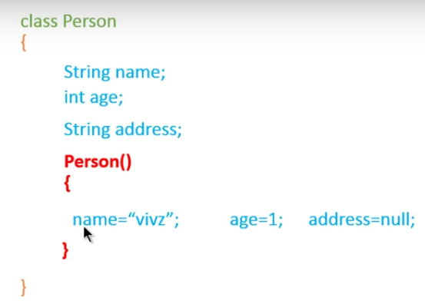

Slide 16
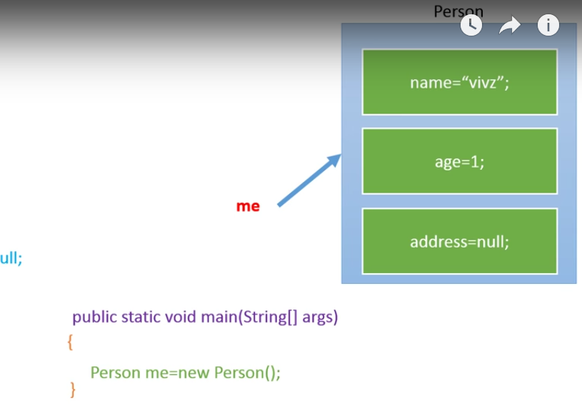

Slide 17
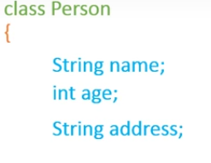
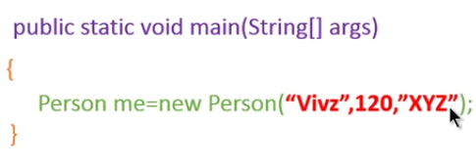
Parameterized Constructor

Slide 18
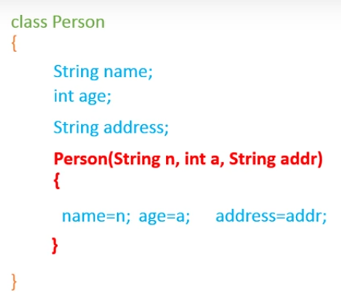

Slide 19
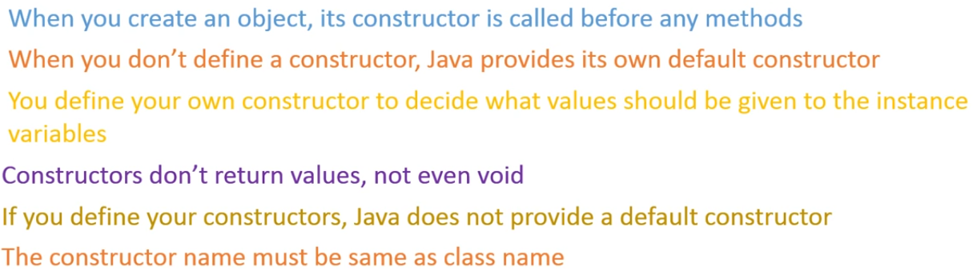
Concluding points

